Slide 1


Team 30: ECEN 215 Lab Kit
Bi-Weekly Update 1 Members: Luis Diaz-Santini, Yusuf Hossain,
Ryan Freed, and Peter Zhang Sponsor: Dr. Lusher
TA: Garret Brown
Notes:
Intro should take 30 seconds

Slide 2
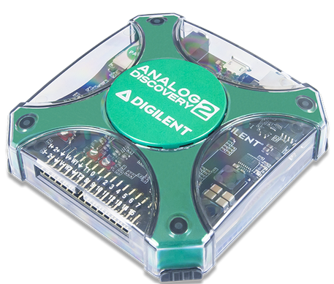
Project Summary
Problem Statement:
Principles of Electrical Engineering (ECEN 215) teaches the basics of electric circuit analysis and electronics to non-ECEN majors.
The transition of ECEN 215 to an online format poses a challenge due to its lab component relying on the Analog Discovery 2 (AD2), which is expensive.
Solution Proposal:
The ECEN 215 Lab Kit offers a solution to the cost, convenience, and over complication issues that are abundant with the AD2. Aiming for a $50 price point, the lab kit offers a more catered simpler approach to each lab while also making it possible to complete at home.
Will operate as the power supply, signal generator, multimeter, and Oscilloscope.

Slide 3
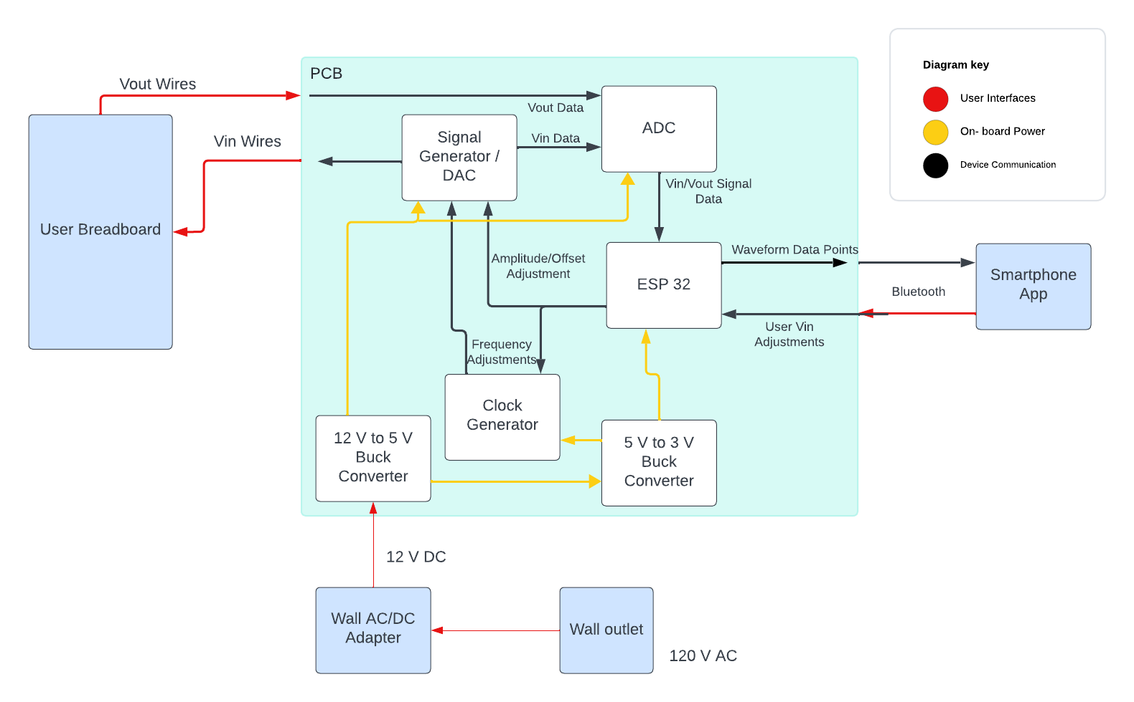
Subsystems Overview
Peter:
Multimeter and Oscilloscope
Yusuf:
Waveforms and communicating to the microcontroller.
Luis:
Create mobile application to interface with device
Ryan:
PCB design and power.

Slide 4
Major Project Changes for 404
Switched from an external IC for the waveform generation to just using the ESP32
Notes:
45 Seconds long

Slide 5
Project Timeline
Ensure Working Subsystem
Complete Subsystems
/ Begin Integration
Complete Testing
Aug. 29
Oct. 16
Nov. 10
Aug. 22
Sept. 9
Oct 30.
Documentation and Buffer Time
Research Integration
/ Ensure Working Subsystems
Complete Integration
/ Begin Testing
Notes:
Eric

Slide 6
Oscilloscope and Multimeter
Peter Zhang
Accomplishments since 403 10 hrs of effort | Ongoing progress/problems and plans until the next presentation
ESP32 and ADC reads data properly | Communicate to mobile application via Bluetooth Send and receive graph to mobile application

Slide 7
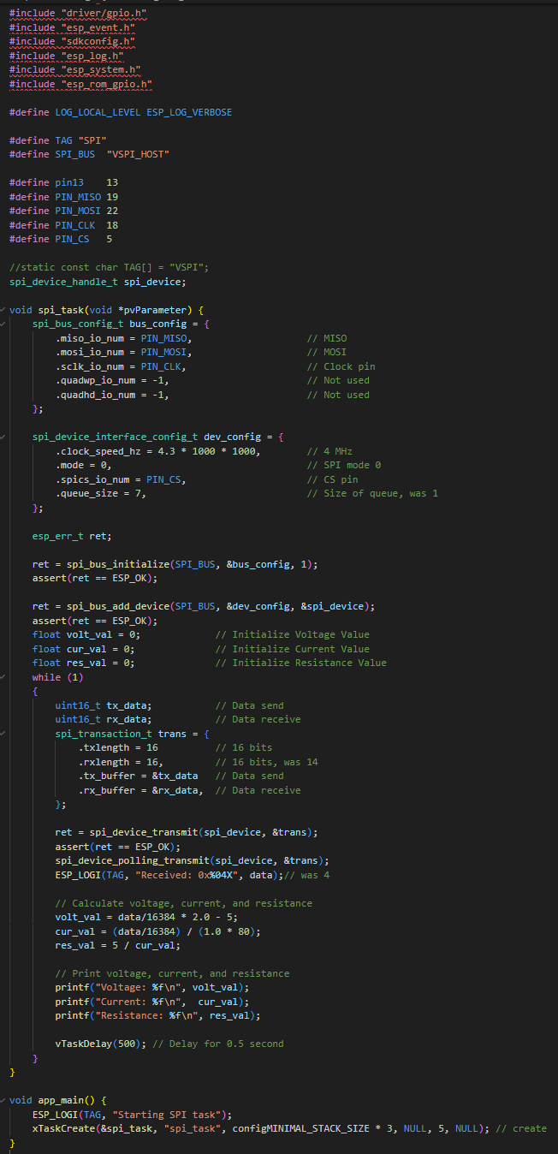

Oscilloscope and Multimeter
Peter Zhang

Slide 8
Waveform Generator
Yusuf Hossain
Accomplishments since 403 10 hrs of effort | Ongoing progress/problems and plans until the next presentation
Waveform generator requirements fully met Successful bluetooth pairing between ESP32 and smartphone device | Sending and receiving messages isn't working correctly working on receiving inputs from the phone app and displaying the graphs

Slide 9
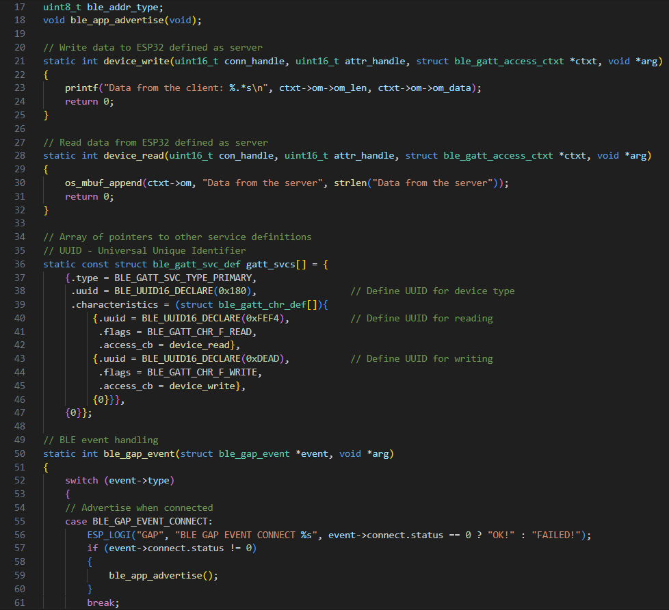
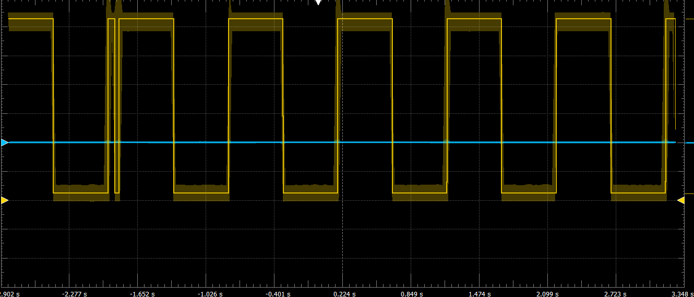
Waveform Generator
Yusuf Hossain

Slide 10
Mobile App
Luis Diaz-Santini
Accomplishments since 403 12 hrs of effort | Ongoing progress/problems and plans until the next presentation
Mobile application is fully up and running once again Application is able to send/recieve messages to and from ESP32 using Arduino | Implement bluetooth functionality using Espressif IDF Send input data to waveform generator and receive waveform graph to display on app

Slide 11
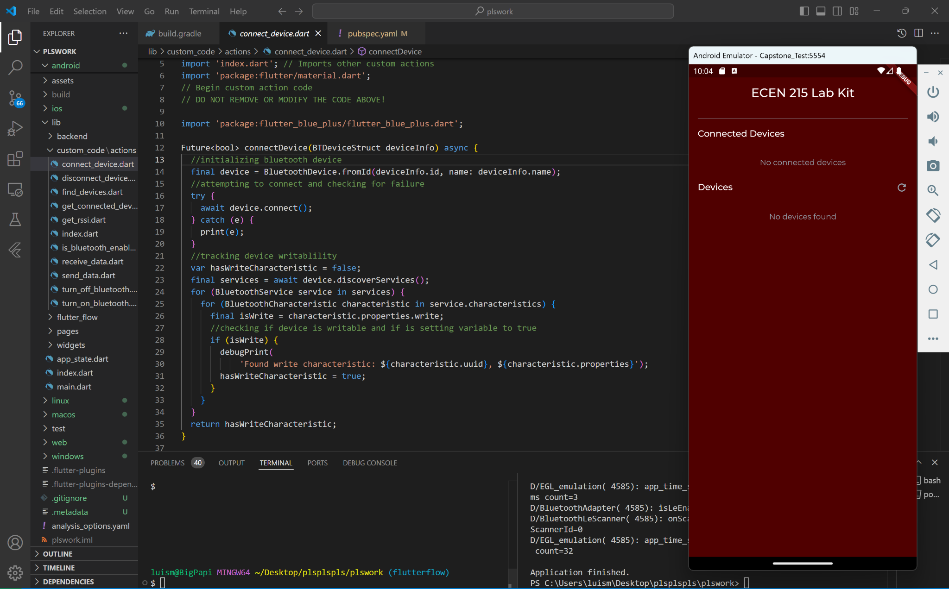
Mobile App
Luis Diaz-Santini

Slide 12
PCB and Power
Ryan Freed
Accomplishments since 403 16 hrs of effort | Ongoing progress/problems and plans until the next presentation
Board size reduced by about 30% to a size of 5260x3200 mils Waveform generator system removed and replaced with ESP32 signal Revised physical user interface methods | Finish revised PCB review, order PCB Finish PCB case design Solder components onto the board, testing gradually during assembly

Slide 13
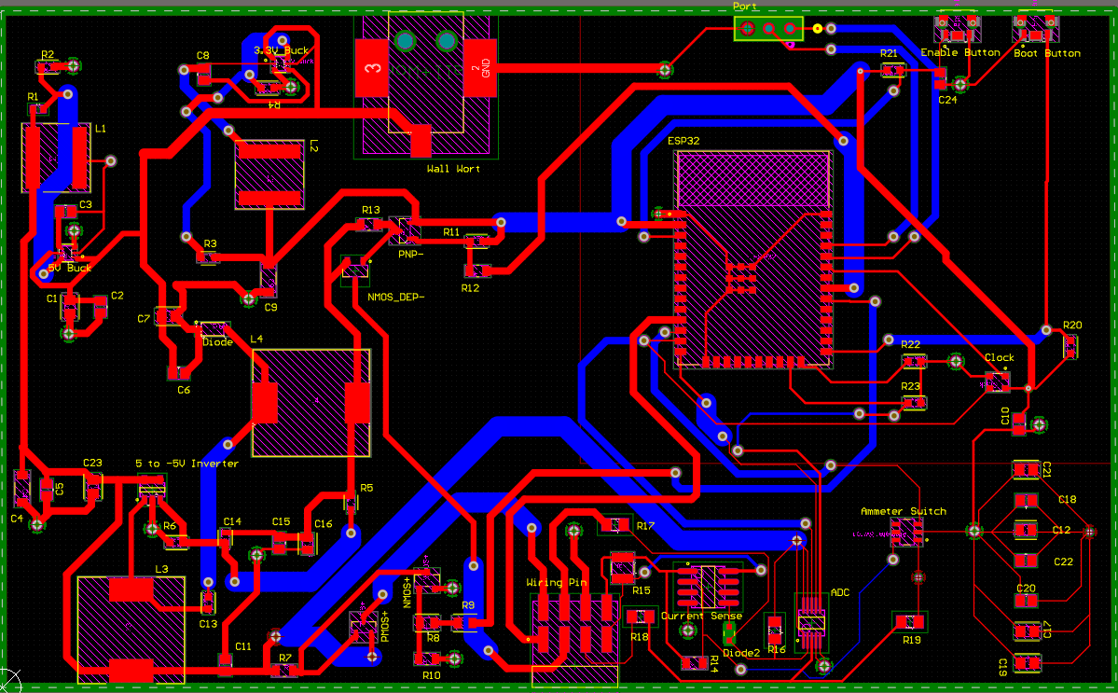
PCB and Power
Ryan Freed
Requested size was approximately the size of a mobile phone (about 72 x 152mm)
Board after size reduction is at 81.3 x 133.6mm
Waveform generator removed and user interface updated (side mounted buttons and wall jack)
Revised PCB Design

Slide 14
Parts Ordering Status
Ordering revised PCB, new DC power jack, and new buttons
Will submit order as soon as PCB design sanity check is completed
Parts should be received and soldered onto the board before next presentation
Notes:
Michelle

Slide 15
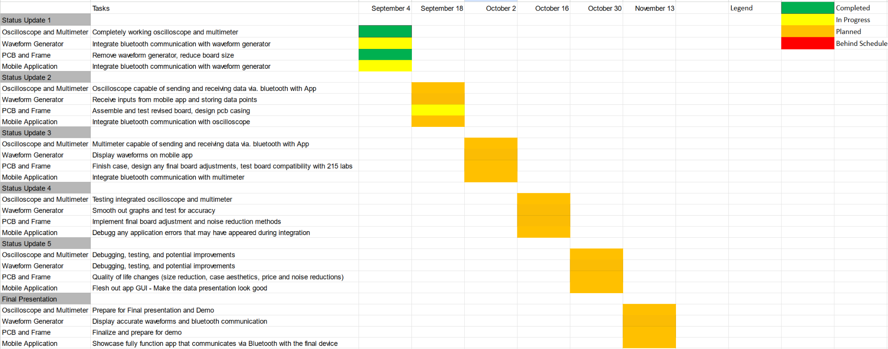
Execution & Plan
Notes:
Michelle

Slide 16
Thank you

